Slide 1
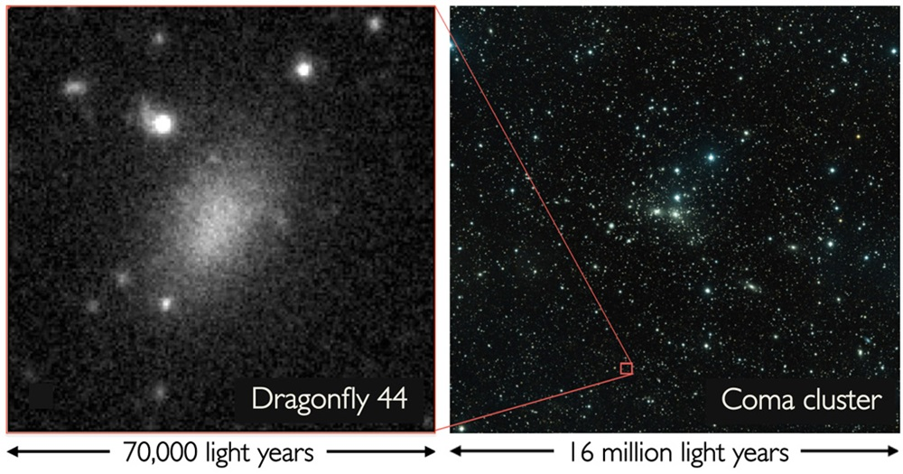

Notes:
A dark matter galaxy has been discovered in the Coma cluster of galaxies, a grouping of about over 1000 galaxies located about 300 million light years from Earth. Pieter van Dokkum and colleagues noticed that the cluster contained several very faint galaxies, including Dragonfly 44, shown here. Dragonfly 44 is unusual in that it has about the same mass of our galaxy, equivalent to about 1 trillion suns, but only has the light of about 1 billion, or about 1% of the number of stars that the Milky Way has. This suggests that this galaxy consists of 99.99% dark matter. While the cause of the galaxy having so few stars isn’t known, suggestions include the gas and dust required to form stars being stripped away by an encounter with other galaxies in the cluster, or a highly energetic event like a series of supernovae or a strong quasar could have blown the dust away before more stars could form.

Slide 2
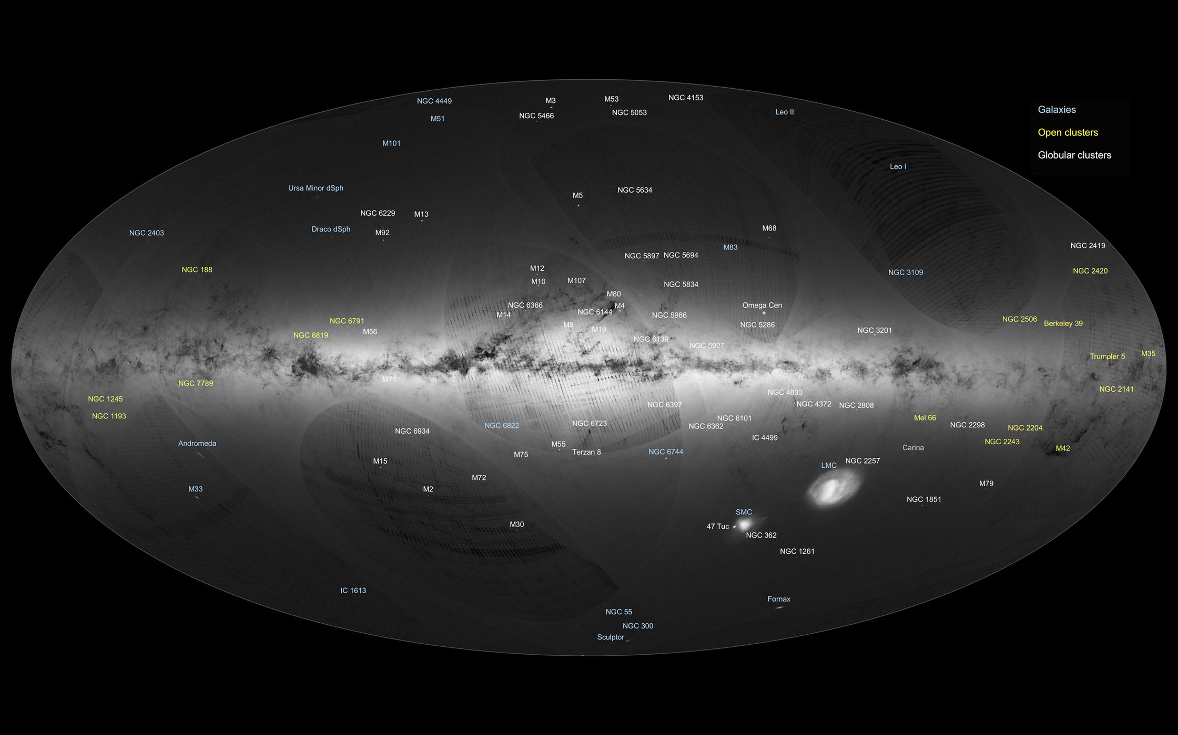
Notes:
Esa GAIA Mission has first data release, with positions of 1 billion stars and distances to over 2 million stars. Prior to this data release, the positions of only about 2.5 million stars had been mapped by the Hipparcos satellite in the 1990s, of which the distance of only about 100,000 of those were known. The Gaia release is still less than 1% of the stars in our Galaxy.
The Gaia satellite is still imaging the sky and will provide more information for those billion stars that were mapped, and is expected to increase the number of stars for which the distance is known to about 20 million. The Gaia mission will also determine the motion of many of those 1 billion stars relative to our solar system. This will give us the most comprehensive map of and understanding of the motion of our galaxy to date.

Slide 3
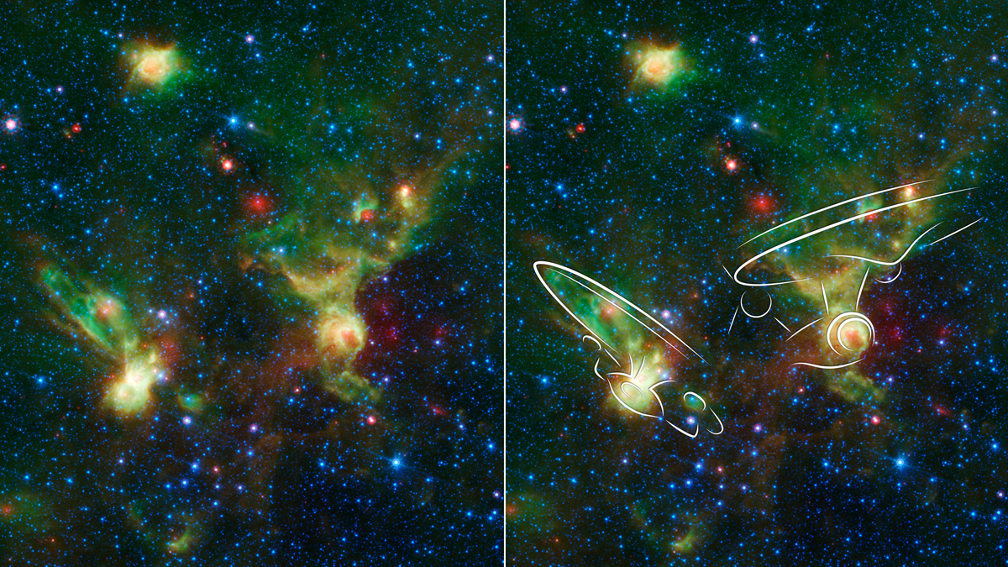
Notes:
Not much science here, but two nebulae imaged by the Nasa Spitzer Space telescope bear a vague resemblance to the Enterprises of Star Trek and Star Trek the Next Generation. These images were released on Sept. 8 in honor of the 50th anniversary of the airing of the original Star Trek. These nebulae are regions where new stars are forming, perhaps places where alien life will exist in a few billion years.

Slide 4
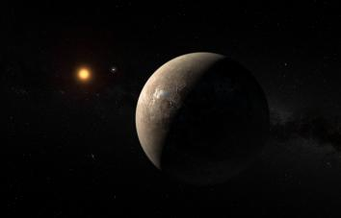

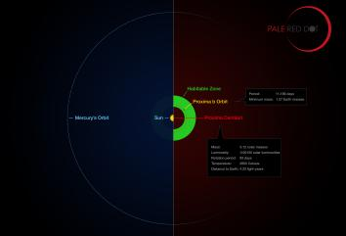
Notes:
The biggest story this past month, was the discovery of an exoplanet around the nearest star to earth, only 4.2 light-years away from our own solar system. Proxima b is slightly larger than earth and orbits its star in just 11 days and is in the habitable zone of its host star, where liquid water could be stable. Using the European Southern Observatory’s HARPS spectrograph in Chile, the team measured the host star’s ‘wobble’ that Proxima b exerts on the star by observing it every night from January 19th to Marth 31st of this year. Since this exoplanet orbits its star in such a short period, it might be tidally locked, like the moon. In order to find out if this planet has an atmosphere, we need to wait a few years for giant telescopes like the ESO’s Extremely Large Telescope and the GMT.
4

Slide 5
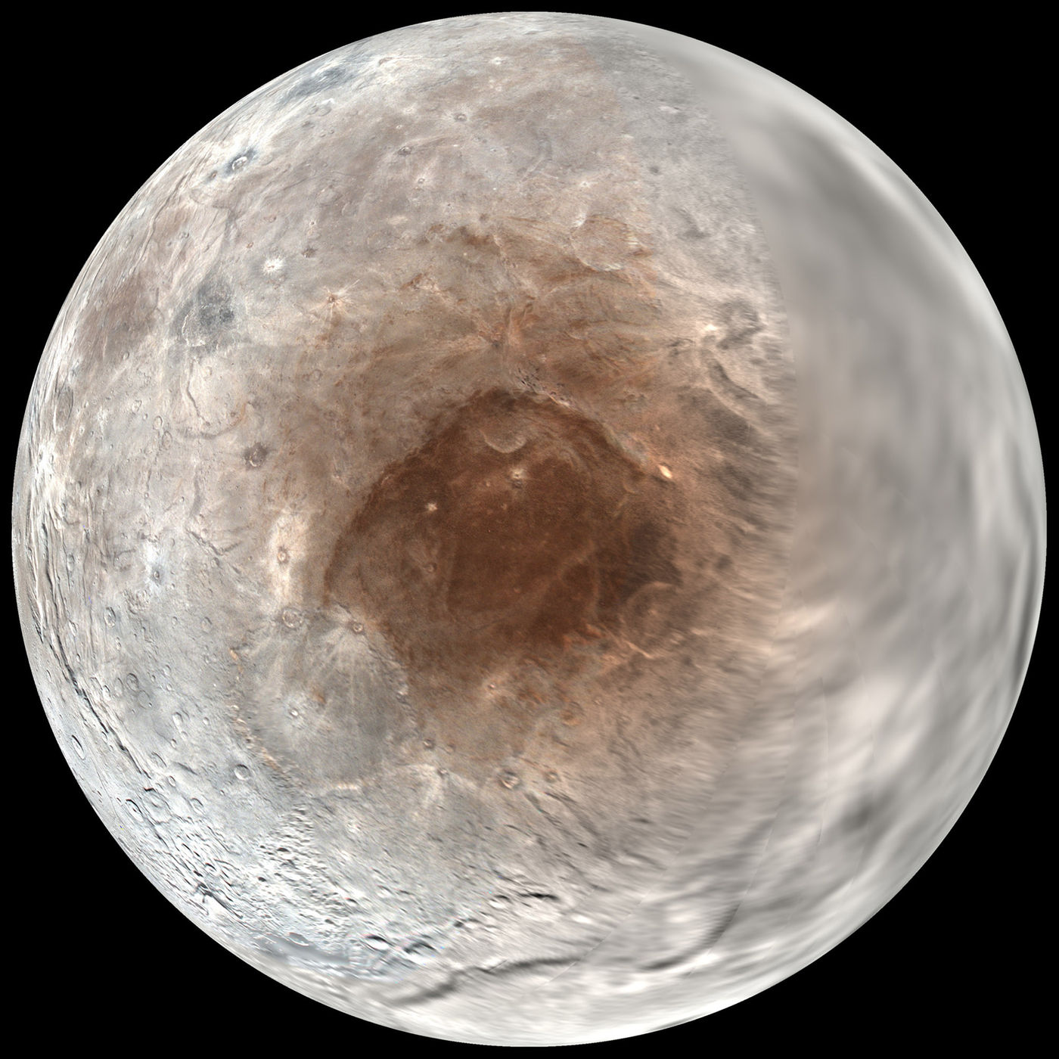
Notes:
NASA just announced that they the red spot on Pluto’s moon Charon may be from Pluto’s atmosphere. Since Pluto is so small, it can not hold all of its atmosphere so it ‘travels’ and over billions of years Pluto’s atmosphere freezed out onto charon. They found evidence that the methane from Plutos atmosphere froze and radiation stripped its hydrogen to leave carbon behind that combined with other molecules to make heavier fragments and because they are carbon-rich they produce the reddish color seen.
5

Slide 6
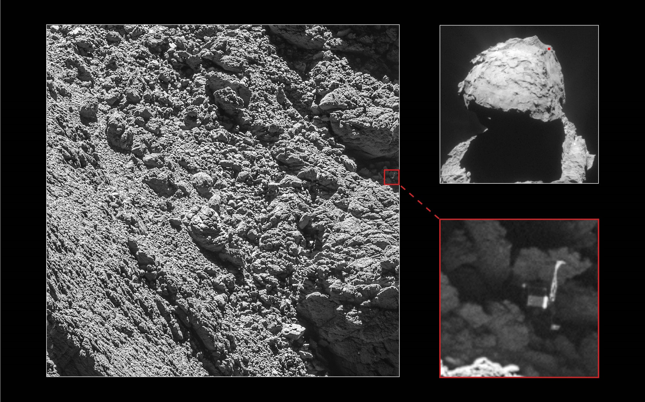
Notes:
The Rosetta probe took close up pictures of comet 67P/Churyumov–Gerasimenko, and has discovered the final location of the Philae lander. Philae landed on the surface of the comet on Novermber 14, 2014. It was supposed to gently land on the surface then screw itself down, instead it bounced off the surface before falling back to land. It’s position next to the boulder prevented it from getting enough sunlight to keep the battery charged, and contact was lost after about 8 hours. Some images and science data were received in that time, but Philae’s final location and orientation weren’t known. The Rosetta spacecraft took this picture from about 3 km away from the comet as it slowly descends toward the surface. Rosetta will also land on the surface in about a week, on September 30. Rosetta is not designed to be a lander, but is expected to continue providing useful data from the surface.

Slide 7



